Slide 1
Data Link Layer
Framing, Error detection and Error correction, Vertical Redundancy Check (VRC), Longitudinal Redundancy Check (LRC), Hamming Distance, Hamming Code, Cyclic Redundancy Check (CRC), Stop and Wait Protocol, Sliding Window Protocol, Go-Back-n ARQ, Selective-Reject ARQ, HDLC, Channel Allocation, ALOHA Systems, CSMA Protocols, Collision Free Protocols

Slide 2
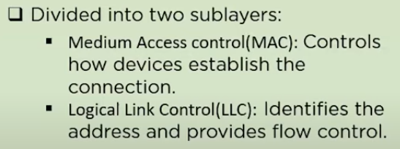
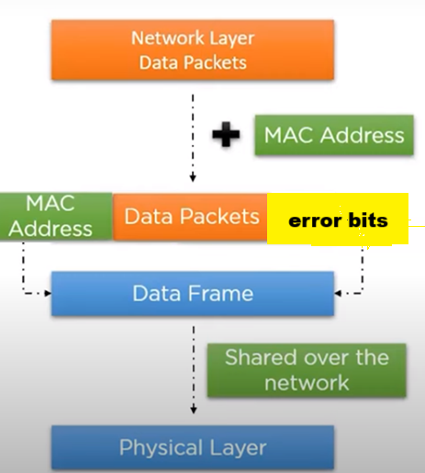
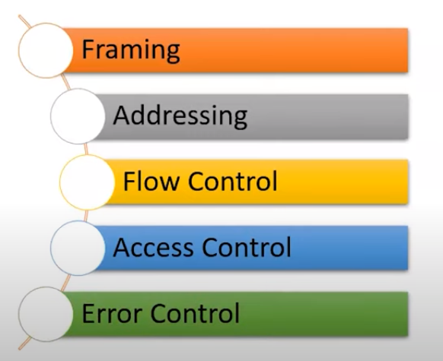
Data Link Layer
Service | Sublayer
Framing | MAC
Addressing
Access Control
Flow control | LLC
Error control

Slide 3
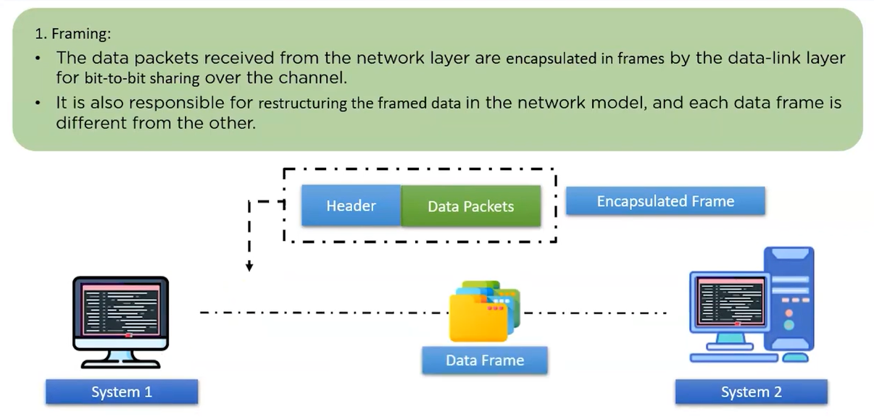
Data Link Layer

Slide 4
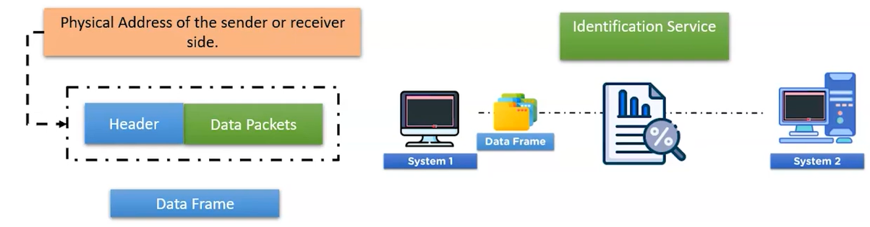
Data Link Layer
2. Addressing:
The Data link layer appends the physical address in the header of the frame before sending it to physical layer.
The physical address contains the address of the sender and receiver.
In case the receiver happens to be on the same physical network as the sender; the receiver is at only one hop from the sender and the receiver address contains the receiver‘s physical address.
In case the receiver is not directly connected to the sender, the physical address is the address of the next node where the data is supposed to be delivered.

Slide 5
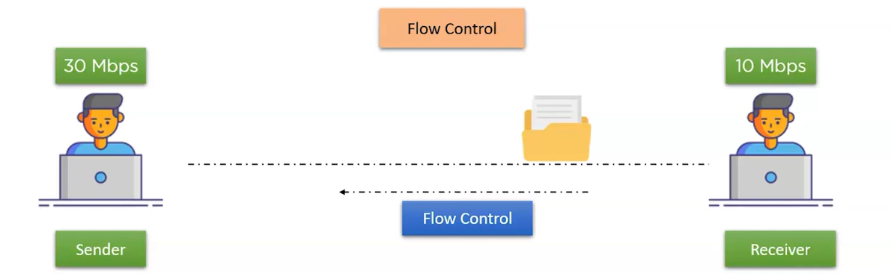
Data Link Layer
3. Flow control
The data link layer makes sure that the sender sends the data at a speed at which the receiver can receive it else if there is an overflow at the receiver side the data will be lost.
The data link layer imposes flow control mechanism over the sender and receiver to avoid data loss at the receiver.

Slide 6
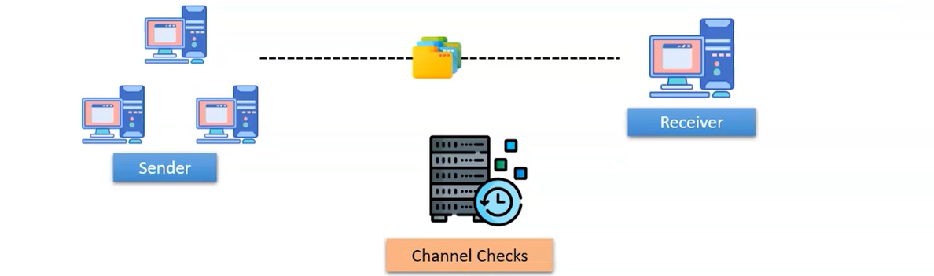
Data Link Layer
4. Access Control
The data link layer imposes access control mechanism to determine which device has right to send data in a multipoint connection scenario.

Slide 7
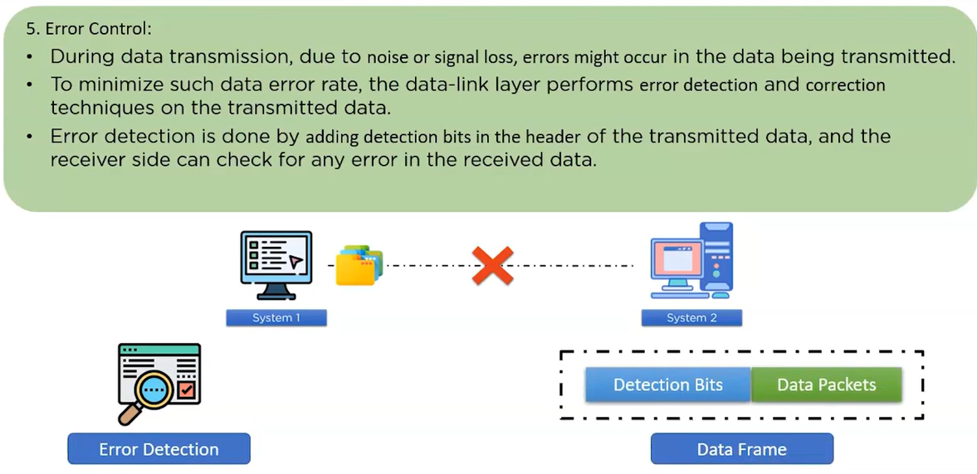
Data Link Layer
trailer

Slide 8
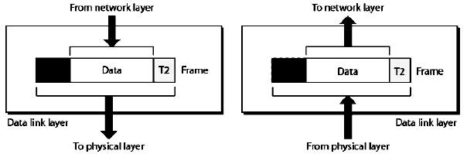
Data Link Layer
I. The Data Link layer adds reliability to the physical layer by providing error detection and correction mechanisms.
II. On the sender side, the Data Link layer receives the data from Network Layer and divides the stream of bits into fixed size manageable units called as Frames and sends it to the physical layer. On the receiver side, the data link layer receives the stream of bits from the physical layer and regroups them into frames and sends them to the Network layer. This process is called Framing. It is shown in the figure below:
Fig: Data Link Layer: The process of Framing

Slide 9
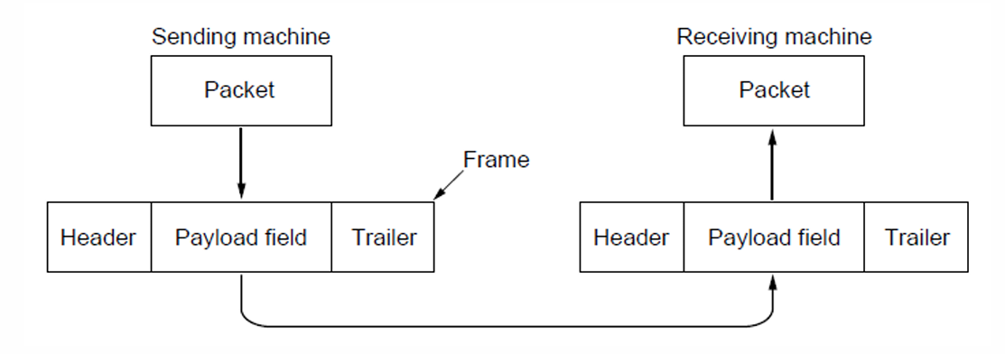
Data Link Layer
Network layer – packets/data packets - stream of bits / Divide the stream of bits into fixed size manageable units– payload field
101011101010101010101011101010101010111
Header – physical address/MAC address of sender and receiver
Trailer – error detection bits

Slide 10
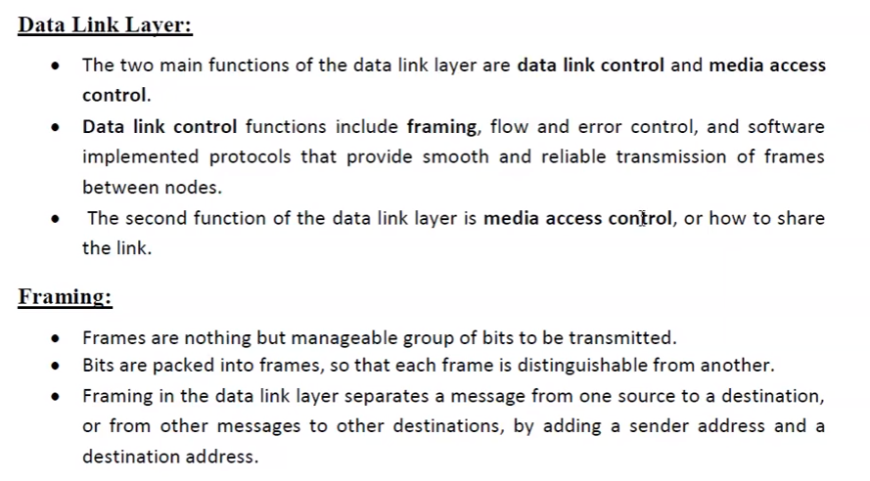
3.2 Framing and its types

Slide 11
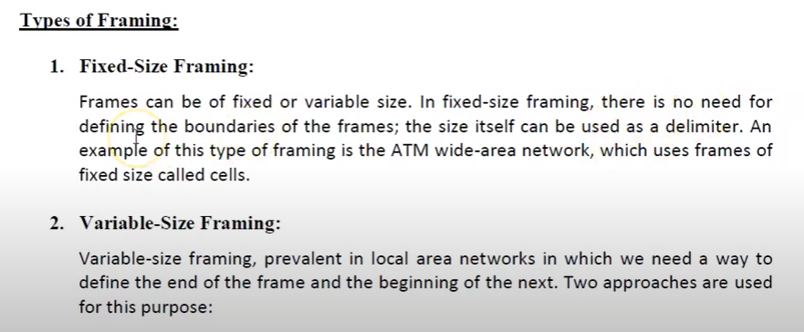
3.2 Framing and its types

Slide 12
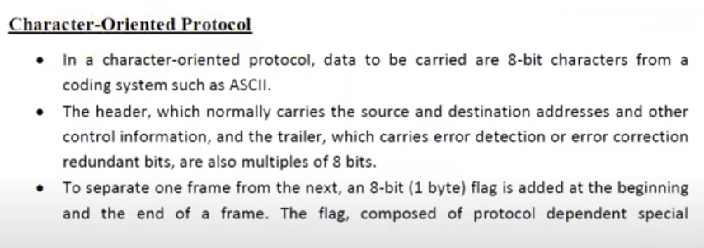
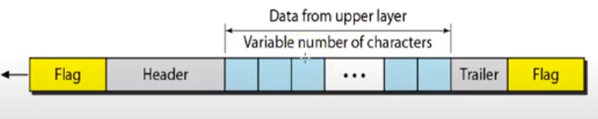
3.2 Framing and its types

Slide 13
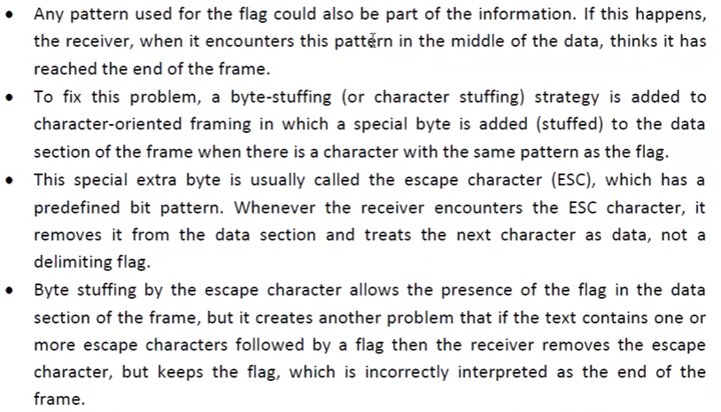
3.2 Framing and its types

Slide 14
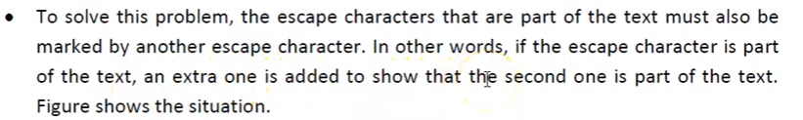
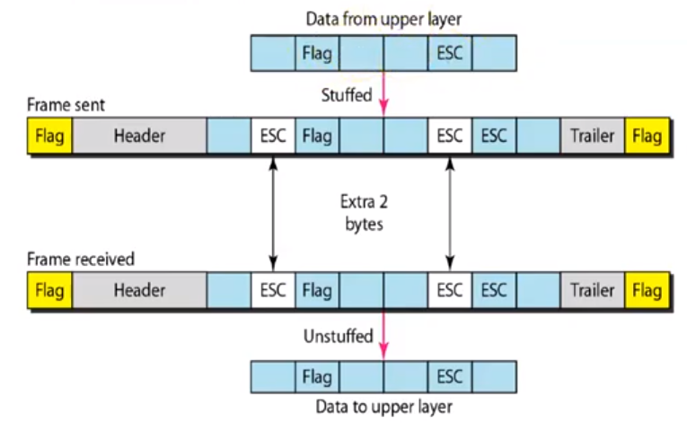
3.2 Framing and its types

Slide 15
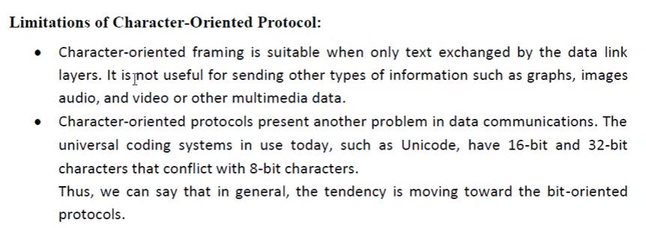
3.2 Framing and its types

Slide 16
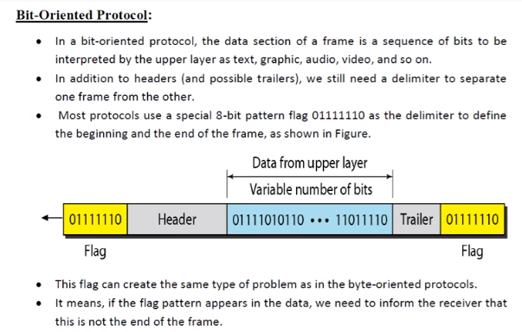
3.2 Framing and its types

Slide 17
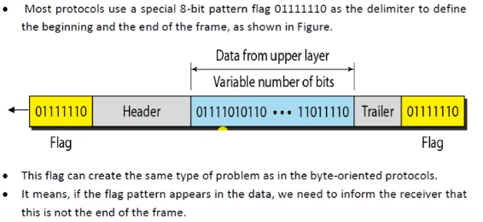
3.2 Framing and its types

Slide 18
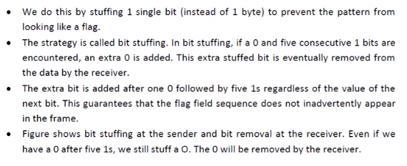
3.2 Framing and its types

Slide 19
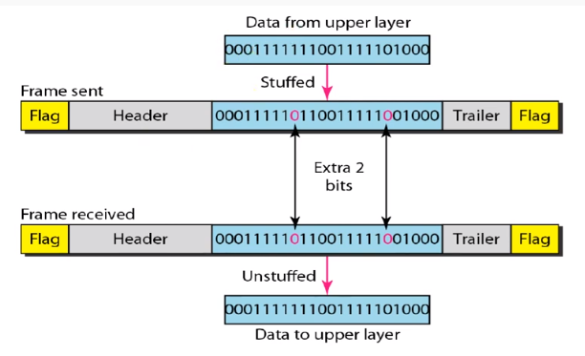

3.2 Framing and its types

Slide 20

3.2 Framing and its types

Slide 21
Data can be corrupted during transmission.
Some applications require that errors be detected and corrected.

Slide 22
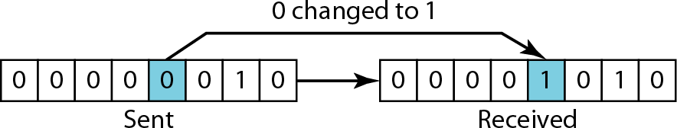
Types of Error
Single-bit error
In a single-bit error, only 1 bit in the data unit has changed.

Slide 23
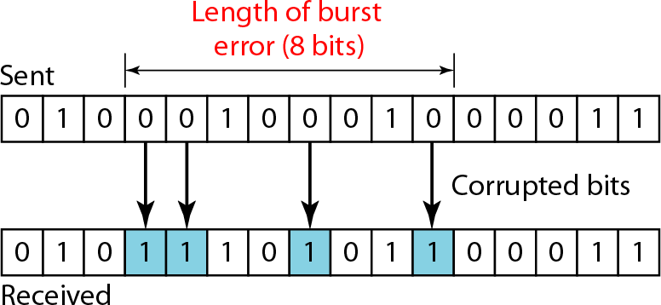
Types of Error
Burst error
A burst error means that 2 or more bits in the data unit have changed.
Note that a burst error does not necessarily mean that the errors occur in consecutive bits.
The length of the burst is measured from the first corrupted bit to the last corrupted bit.
Some bits in between may not have been corrupted.

Slide 24



Error Detection
Redundancy : is the central concept in detecting & correcting errors.
We need to send some extra bits with our data. These redundant bits are added by the sender and removed by the receiver .
To detect or correct errors, we need to send extra (redundant) bits with data.
Data Extra bits (Redundant bits)

Slide 25
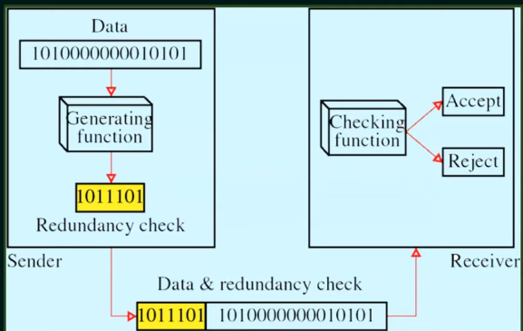
Figure The structure of encoder and decoder

Slide 26
Detection Versus Correction
In error detection , we are looking only to see if any error has occurred. A single-bit error is the same for us as a burst error.
In error correction , we need to know the exact number of bits that are corrupted and more importantly, their location in the message.
Note: correction of errors is more difficult than the detection

Slide 27
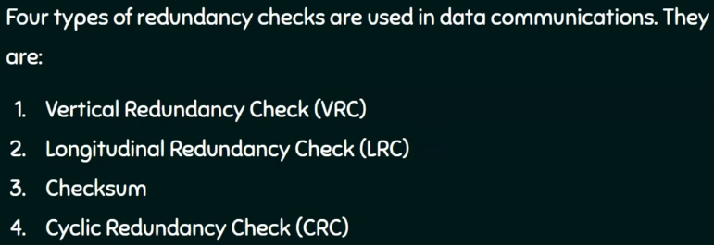
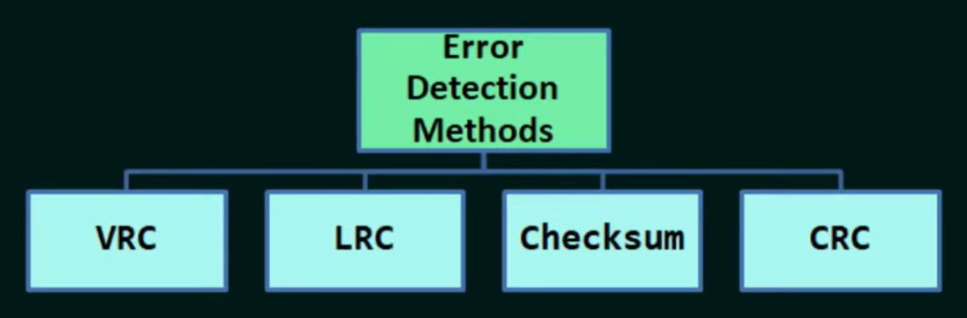
Error Detection Techniques

Slide 28
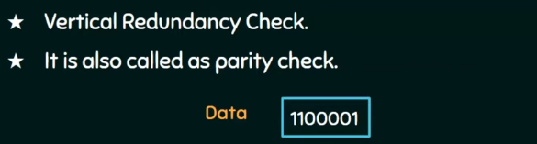
VRC

Slide 29
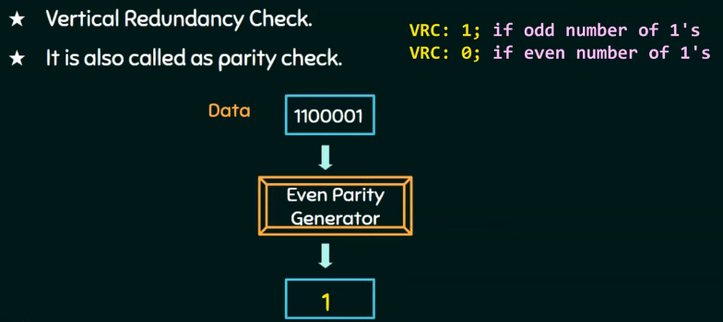
VRC
Parity generator will count number of 1s in data unit and will add parity bit.

Slide 30
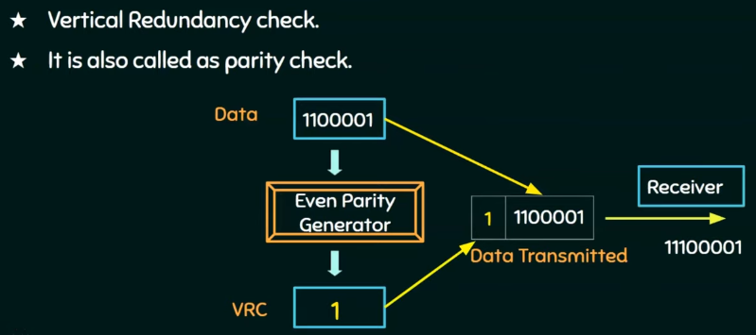
VRC

Slide 31
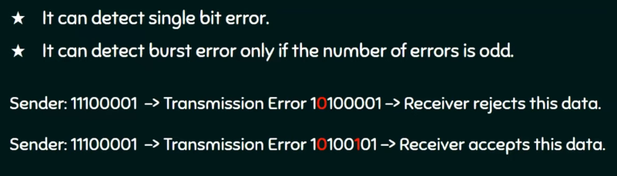
VRC

Slide 32

VRC
Find the even parity bit (VRC) for the following message stream:

Slide 33
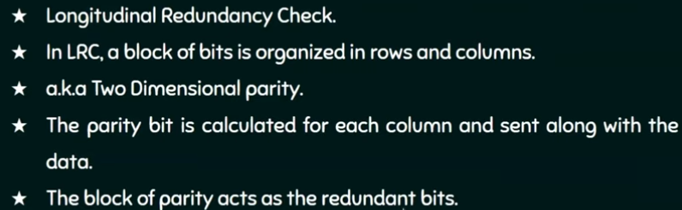
LRC

Slide 34
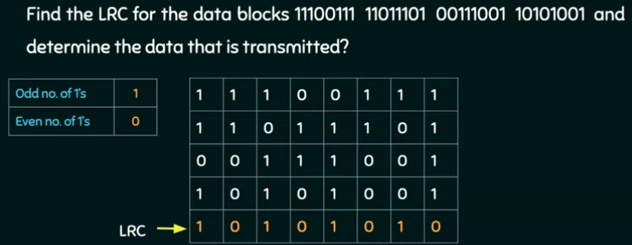
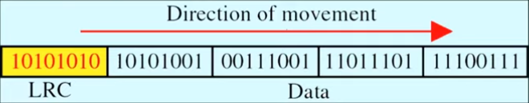
LRC

Slide 35
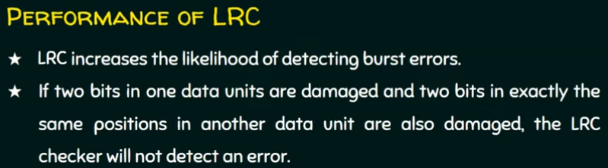
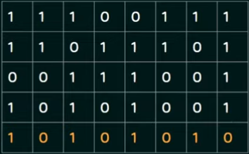
LRC

Slide 36
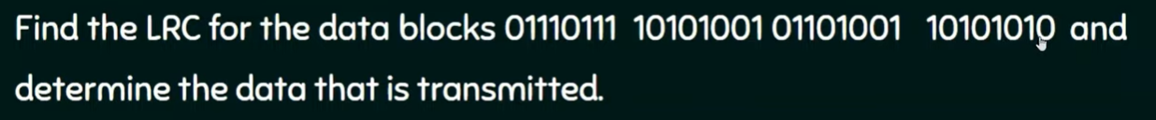
LRC

Slide 37
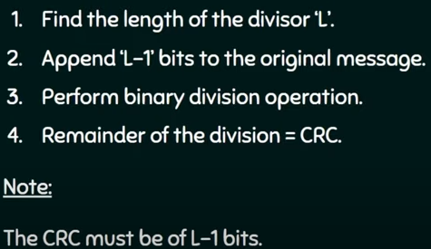
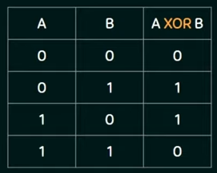
Cyclic Redundancy Check
It is one of the error detection technique
Steps for finding the redundant bits

Slide 38
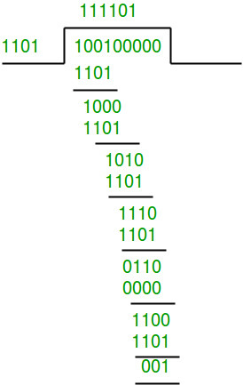
the remainder is 001 and hence the encoded data sent is 100100001.
Cyclic Redundancy Check
The remainder is 001 and
hence the transmitted data is 100100001.

Slide 39
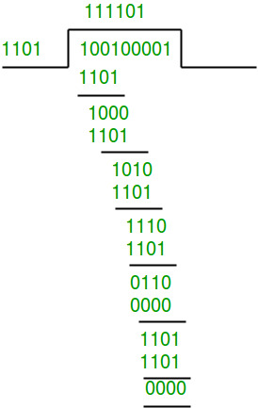
the remainder is 001 and hence the encoded data sent is 100100001.
Cyclic Redundancy Check
Receiver Side:
Received bits 100100001
The remainder is all zeros.
Hence, the data received has no error.

Slide 40
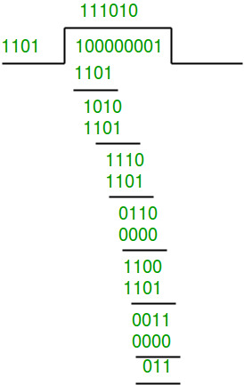
the remainder is 001 and hence the encoded data sent is 100100001.
Cyclic Redundancy Check
Receiver Side:
Received bits 100000001
The remainder is not all zeros.
Hence, the error is detected at the receiver side.

Slide 41
the remainder is 001 and hence the encoded data sent is 100100001.
Cyclic Redundancy Check
Exercise:

Slide 42
Error Correction
There are two main methods of error correction.
Forward error correction is the process in which the receiver tries to correct the error using error correction techniques.
Correction by retransmission is a technique in which the receiver detects the occurrence of an error and asks the sender to resend the message. Resending is repeated until a message arrives that the receiver believes is error-free (usually, not all errors can be detected)

Slide 43
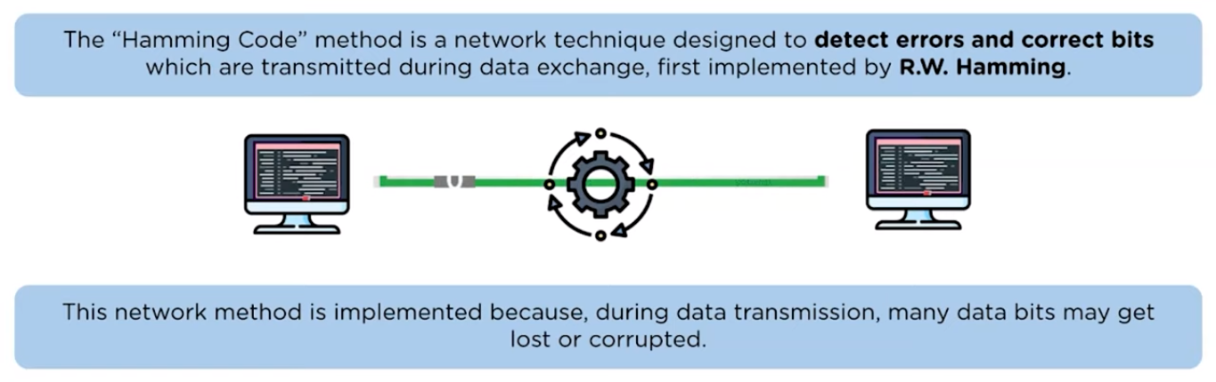
What is Hamming Code?

Slide 44
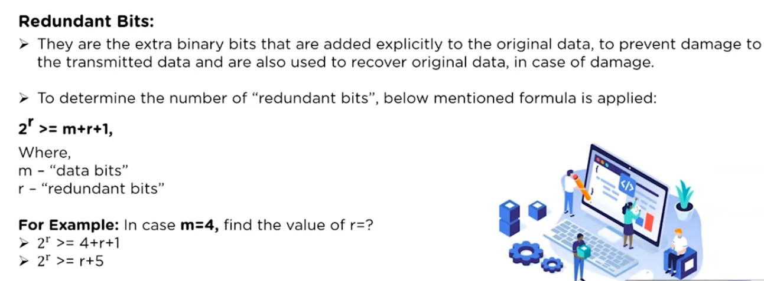
Terms Related to Hamming Code

Slide 45
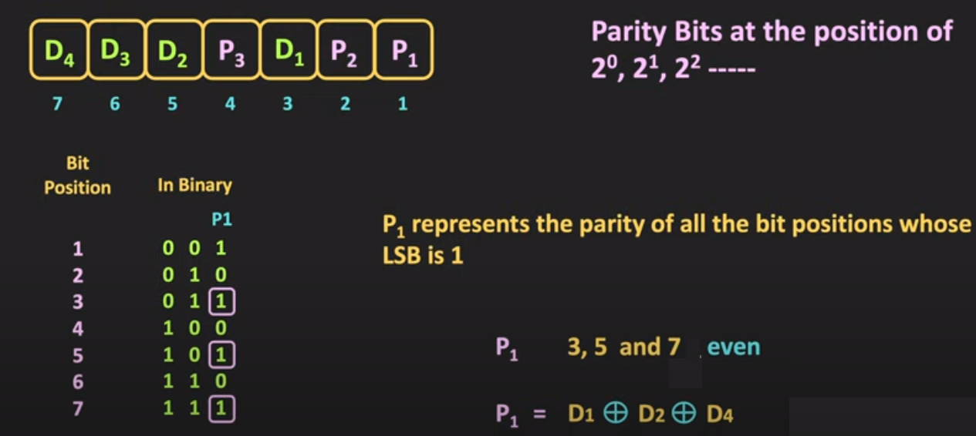
Hamming Code(7,4)

Slide 46
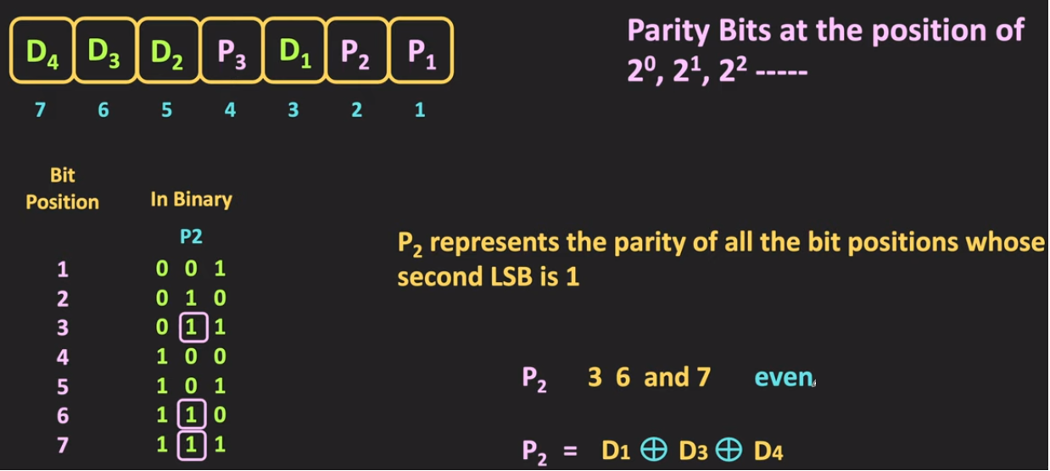
Hamming Code(7,4)

Slide 47
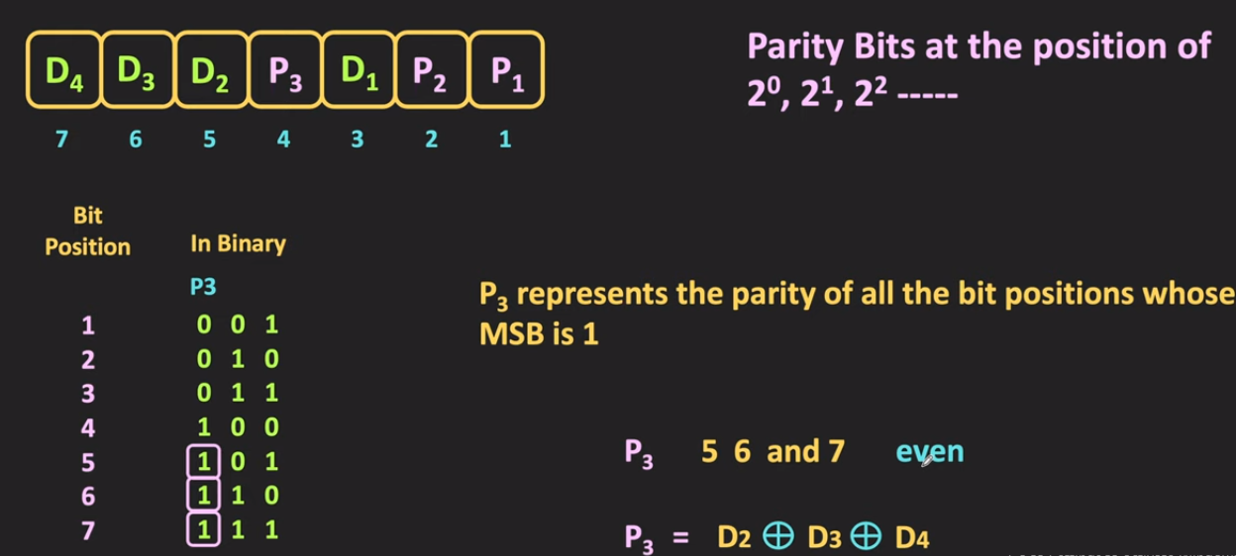
Hamming Code(7,4)

Slide 48
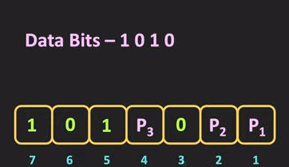
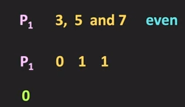
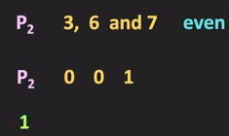


Hamming Code(7,4)
Parity Bit Calculation:
Transmitted Bit

Slide 49

Error Detection – Hamming Code
Parity Bits |  | Calculated Parity
P₁ – 3,5,7 – P₁,D₁,D₂,D₄ | P₁,D₁,D₂,D₄ - 0 0 1 1 | 0
P₂ – 3,6,7– P₂,D₁,D₃,D₄ | P₂,D₁,D₃,D₄ - 1 0 1 1 | 1
P₃ – 5,6,7– P₃,D₂,D₃,D₄ | P₃,D₂,D₃,D₄ - 0 1 1 1 | 1
Calculated Parity bits are not zero. It indicates that there is error in the received bits – Error is detected

Slide 50
Error Detection – Hamming Code
Transmitted Bits – 1010010
Received Bits – 1010010
D₁ – 0 , D₂ – 1, D₃ – 0, D₄ – 1
Parity Bits | Calculated Parity | Received Parity | Check Received = Calculated
P₁ – 3,5,7 –D₁,D₂,D₄ – 0,1,1 | 0 | 0 | 0
P₂ – 3,6,7–D₁,D₃,D₄ – 0, 0, 1 | 1 | 1 | 0
P₃ – 5,6,7–D₂,D₃,D₄- 1,0,1 | 0 | 0 | 0
The received and calculated parity bits are same. It indicates that there is no error in the received bits

Slide 51
Error Correction – Hamming Code
Parity Bits | Calculated Parity | Received Parity | Check Calculated Parity = Received Parity (Syndrome)
P₁ – 3,5,7 – D₁,D₂,D₄ – 0, 1, 1 | 0 | 0 | 0
P₂ – 3,6,7– D₁,D₃,D₄- 0, 1, 1 | 0 | 1 | 1
P₃ – 5,6,7– D₂,D₃,D₄ – 1, 1, 1 | 1 | 0 | 1
The received and calculated parity bits are not same. It indicates that there is an error in the received bits
Syndrome – (110)₂ – 6 indicated the error bit position
6th bit position value is 1 so to correct the error it should be flipped
Corrected data is 1010010

Slide 52
Hamming Distance
The Hamming distance between two
words is the number of differences between corresponding bits.
The Hamming distance can easily be found if we apply the XOR operation (⊕) on the two words and count the number of 1’s in the result.

Slide 53
Hamming Distance
Let us find the Hamming distance between two pairs of words.
1. The Hamming distance d(000, 011) is 2 because
2. The Hamming distance d(10101, 11110) is 3 because

Slide 54

Minimum Hamming Distance
The minimum Hamming distance is the smallest Hamming distance between all possible pairs in a set of words.
Minimum Hamming distance = d_{min} = 1
Where, n is the total number of bits
k is the number bits in the data

Slide 55

Minimum Hamming Distance
If the minimum hamming distance is 9 then how many errors can be detected and corrected by those codewords?
For (11,7) hamming code, how many errors can be corrected and detected?

Slide 56
PROTOCOLS
In data link layer the flow control is achieved through the protocols. The protocols are normally the set of rules and implemented using software by using one of the common programming languages.

Slide 57

Taxonomy of protocols

Slide 58
Data Link Layer Protocol - Stop and Wait Protocol
  Stop-and-wait protocol provides data transmission with flow control facilities but without error control facilities.
  The sender sends a one data frame at a time and waits, until receiving an acknowledgement from the receiver.
A
B
Frame 0
Ack
Frame 1
Ack
Frame 2
Ack

Slide 59
Data Link Layer Protocol - Stop and Wait Protocol
Problems of stop-and-wait protocol
Problem due to lost data
  Sender waits for ack for an infinite amount of time
  Receiver waits for data an infinite amount of time
Problems due to lost ACK
  Sender waits for an infinite amount of time for the ACK
Problems due to delayed ACK/data
  After timeout on sender side, a delayed ack might be wrongly considered as ack of some other data packet
Normal case
1
2
3
Err
Frame loss
Err
Ack loss
delayed Ack

Slide 60

Figure 11.8 Design of Stop-and-Wait Protocol

Slide 61
Algorithm Sender-algorithm for Stop-and-Wait Protocol

Slide 62
Algorithm: Receiver- algorithm for Stop-and-Wait Protocol

Slide 63
Data Link Layer Protocol - Stop and Wait ARQ Protocol
In stop-and-wait protocol, after transmitting one frame, the sender waits for an acknowledgement before transmitting the next frame
If the acknowledgement does not arrive after a certain period of time, the sender times out and retransmits the original frame
Stop-and-wait ARQ protocol = stop-and-wait protocol + timeout timer+ sequence number

Slide 64


Data Link Layer Protocol - Stop and Wait ARQ Protocol
The Ack is received before the timer expires
The original frame is lost

Slide 65


Data Link Layer Protocol - Stop and Wait ARQ Protocol
The Ack is lost
The timeout fires too soon

Slide 66
Pipelining
Pipelining: A task is begun before the previous task has ended
There is no pipelining in stop and wait ARQ because we need to wait for a frame to reach the destination and be acknowledged before the next frame can be sent
Pipelining improves the efficiency of the transmission

Slide 67

Sliding window protocol
Send multiple frames at a time
Number of frames to be sent is based on the Window size
Each frame is numbered → sequence number

Slide 68

Sliding window protocol

Slide 69

Sliding window protocol

Slide 70

Sliding window protocol

Slide 71

Sliding window protocol

Slide 72

Go_Back _N ARQ
It uses the concept of protocol pipelining (i.e.) the sender can send multiple frames before receiving the acknowledgement for the first frame
There are finite number of frames and frames are numbered in a sequential manner
The number of frames that can be sent depends on the window size of the sender
If the acknowledgment of the frame is not received within an agreed upon time period, all the frames in the current window are transmitted.

Slide 73

Go_Back _N ARQ
Working

Slide 74

Go_Back _N ARQ
Working

Slide 75

Go_Back _N ARQ
Working

Slide 76

Go_Back _N ARQ
Working

Slide 77

Go_Back _N ARQ
Working

Slide 78

Go_Back _N ARQ
Working

Slide 79

Figure Design of Go-Back-N ARQ

Slide 80


Figure Send and Receive window for Go-Back-N ARQ

Slide 81



Go_Back _N ARQ

Slide 82
In the Go-Back-N Protocol, the sequence numbers are modulo 2^{m},
where m is the size of the sequence number field in bits.
The send window is an abstract concept defining an imaginary box of size 2^{m} − 1 with three variables: S_{f}, S_{n}, and S_{size}.
The send window can slide one
slot when a valid acknowledgment arrives.
In Go-Back-N ARQ, the size of the send window must be less than 2^{m};
the size of the receiver window is always 1.

Slide 83
Algorithm Go-Back-N sender algorithm
(continued)

Slide 84

Algorithm Go-Back-N sender algorithm
(continued)

Slide 85
Algorithm Go-Back-N receiver algorithm

Slide 86
Selective Repeat ARQ
Go-Back-N ARQ is inefficient of a noisy link.
In a noisy link frames have higher probability of damage , which means the resending of multiple frames.
this resending consumes the bandwidth and slow down the transmission .
Solution:
Selective Repeat ARQ protocol : resent only the damage frame
It defines a negative Acknowledgement (NAK) that report the sequence number of a damaged frame before the timer expires
Correct frames are received and buffered
It is more efficient for noisy link, but the processing at the receiver is more complex

Slide 87

Selective Repeat ARQ
Working

Slide 88

Selective Repeat ARQ
Working

Slide 89

Selective Repeat ARQ
Working

Slide 90

Selective Repeat ARQ
Working

Slide 91

Selective Repeat ARQ
Working

Slide 92

Figure Send window for Selective Repeat ARQ

Slide 93

Figure Receive window for Selective Repeat ARQ

Slide 94

Figure Design of Selective Repeat ARQ

Slide 95
Algorithm Sender-site Selective Repeat algorithm
(continued)

Slide 96
Algorithm Sender-site Selective Repeat algorithm
(continued)
(continued)

Slide 97
Algorithm Sender-site Selective Repeat algorithm
(continued)

Slide 98
Algorithm Receiver-site Selective Repeat algorithm

Slide 99
Algorithm Receiver-site Selective Repeat algorithm

Slide 100

Piggybacking ( Bidirectional transmission)
Is a method to combine a data frame with an acknowledgment.
It can save bandwidth because data frame and an ACK frame can be combined into just one frame

Slide 101
Piggybacking ( Bidirectional transmission)
Communication between the host A and host B, three conditions can arise:
When the host has both data and the acknowledgment to send, then it will attach the data along with the acknowledgment. In the above diagram, the host B will attach the data frame along with the acknowledgment of the last frame received from host A.
When the host does not have any data to send then it will send only the acknowledgment. In the above diagram, when host A does not have any data frame to send. So, it will only send the acknowledgment of the last frame received.
When the host has only data to send then it will send the data along with the acknowledgment of the last frame received. The duplicate acknowledgment will be discarded by the receiver and the data would be accepted.

Slide 102
HDLC

Slide 103
Introduction to HDLC
The High-Level Data Link Control (HDLC) is part of the data link layer protocol in the OSI Model.
The HDLC protocol embeds information in a data frame that allows devices to control data flow and correct errors
HDLC is an ISO Standard developed from the Synchronous Data Link Control (SDLC) standard proposed by IBM
Role of HDLC is to ensure that the data has been received without any loss or errors and in the correct order
It is a bit-oriented protocol

Slide 104


Introduction to HDLC
HDLC is applied for point-to-point and multipoint link structures based on the bit-oriented data format.
It also applies the Automatic Repeat Request (ARQ) for performing full-duplex communication between network channels due to its high flexibility and reliable network structure.

Slide 105



HDLC Stations
To efficiently integrate and use the HDLC protocols, different stations are to be effectively applied in the channel:
Primary Station - It handles establishing and de-establishing the primary data channel to share frames in the network, known as commands.
It also performs data management for the network

Slide 106

HDLC Stations
To efficiently integrate and use the HDLC protocols, different stations are to be effectively applied in the channel:
Secondary Station - They work under the command of the primary station, and the frames transmitted by this station are known as responses.
Secondary Station

Slide 107

HDLC Stations
To efficiently integrate and use the HDLC protocols, different stations are to be effectively applied in the channel:
Combined Station - This network station can work as both the primary and secondary stations and handle commands and responses.

Slide 108

HDLC Transfer Models
The HDLC primarily supports two types of transfer models, which are:
Normal Response Model (NRM) - This transfer model combines primary and secondary stations in point-to-point or multipoint network configurations to exchange commands from primary stations and responses from secondary stations.

Slide 109

HDLC Transfer Models
Asynchronous Balanced Model (ABM) - In this transfer model, combined stations are installed in a point-to-point configuration for exchange commands and responses in a balanced format.

Slide 110
HDLC Transfer Models
Asynchronous Response Model (ARM)
Secondary station initiates a transmission without receiving permission from the primary station
Primary terminal still retains responsibility for line initialization, error recovery, and logical disconnect
Allows the secondary station to send frames asynchronously to the primary station

Slide 111


HDLC Frames and Types
Beginning sequence | Header | Data | Trailer | Ending sequence

Slide 112
HDLC Frames and Types
HDLC Frame Types:
  I – frame: Information frame
  S-frame: Supervisory frame
  U-frame: Un-numbered frame
Types of frame is determined by the control field.
I – frame | 1st bit is 0 | User Information
S-frame | 1st two bits is 10 | Error and flow control
U-frame | 1st two bits is 11 | Link management

Slide 113



HDLC Frames and Types
Note: The first bit of control field is 0 and is used for identifying the I-frame
Seq. No. of next frame expected (bidirectional)
0
Seq. no. frame sent

Slide 114


HDLC Frames and Types
Note: The two bits of control field is 10 and is used for identifying the S-frame

Slide 115


HDLC Frames and Types
Note: The two bits of control field is 11 and is used for identifying the U-frame

